Slide 1
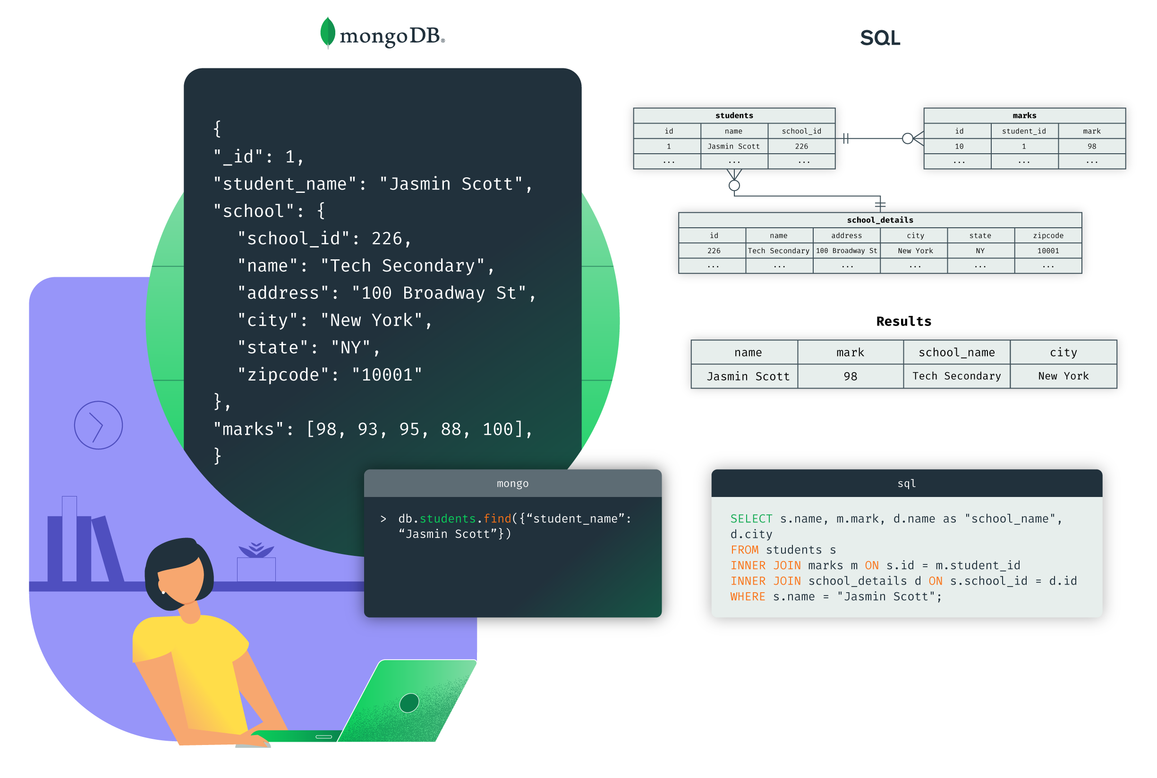
Comparaison bettewen MongoDB and SQL

Slide 2

MongoDB
Presantation
MongoDB is an object-oriented, simple, dynamic and scalable NoSQL database. It is based on the NoSQL document storage model where the data objects are stored as separate and flexible JSON-ike documents.
Functionalities
Document Model: MongoDB is a document-oriented database, which means that data is stored as documents, and documents are grouped in collections.
Flexible Schema: Documents in a single collection don’t necessarily need
tohave exactly the same set of fields. This flexibility allows developers to
iterate faster and migrate data between different schemas without any
downtime.
Scalability: MongoDB is well known for its horizontal scaling and load
balancing capabilities, which has given application developers an
unprecedented level of flexibility and scalability.

Slide 3

SQL
Presantation
Structured Query Language (SQL) s a standard language
for managing and manipulating relational databases
Functionalities
Aggregate Functions: Aggregate functions perform a
calculation on a set of values and return a single value.
Examples include SUM(), AVG(), COUNT(), MIN(),
and MAX()2.
Mathematical Functions: SQL provides mathematical
functions like ABS(), ROUND(), POWER(), and SQRT().
Advanced Functions: SQL provides advanced functions like BIN(), BINARY, CONNECTION_ID(), CURRENT_USER(), DATABASE(), IF(), LAST_INSERT_ID(), SESSION_USER(), SYSTEM_USER(), USER(), and VERSION()

Slide 4
MongoDB vs SQL
The five critical differences between SQL vs NoSQL are:
1. SQL databases are relational, NoSQL databases are non-relational.
2. SQL databases use structured query language and have a predefined schema. NoSQL databases
have dynamic schemas for unstructured data.
3. SQL databases are vertically scalable, while NoSQL databases are horizontally scalable.
4. SQL databases are table-based, while NoSQL databases are document, key-value, graph, or wide-
column stores.
5. SQL databases are better for multi-row transactions, while NoSQL is better for unstructured data like
documents or JSON.

Slide 5
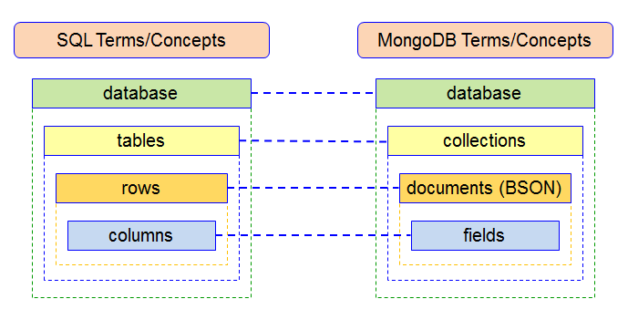
Conclusion
In conclusion, both MongoDB and SQL have their own strengths and are suited to different types of applications.
MongoDB's document-oriented and schema-less data model allows for great flexibility and scalability, making it a good choice for applications that need to handle large amounts of diverse and changing data.
On the other hand, SQL's structured,
table-based approach and strong consistency
guarantees make it a good fit for applications
that require complex transactions with multiple
operations or queries that return precise
results.The choice between MongoDB and
SQL should be based on the specific needs
of your application.

